Slide 1
LinZ Geo QuiZ
24. March 2017
Arora Ravdeep
Breitenfellner Marcel
Obermayr Christian
Punz Jürgen

Slide 2
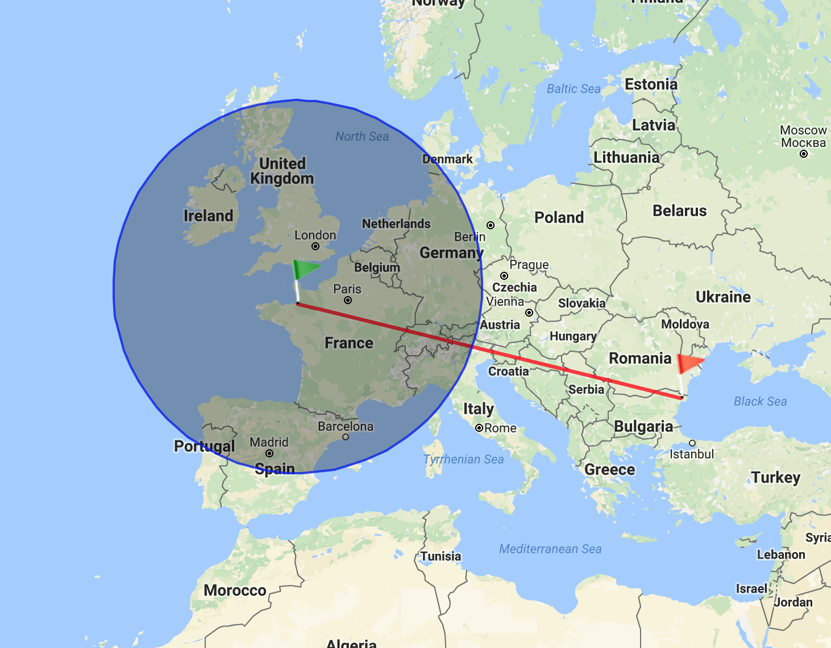
Idea
Geo Quiz for Linz
Displays Distance
Categories
Streets
Buildings
Hospitals
Retirement Homes
Event Locations
Stores
...
Mixed

Slide 3
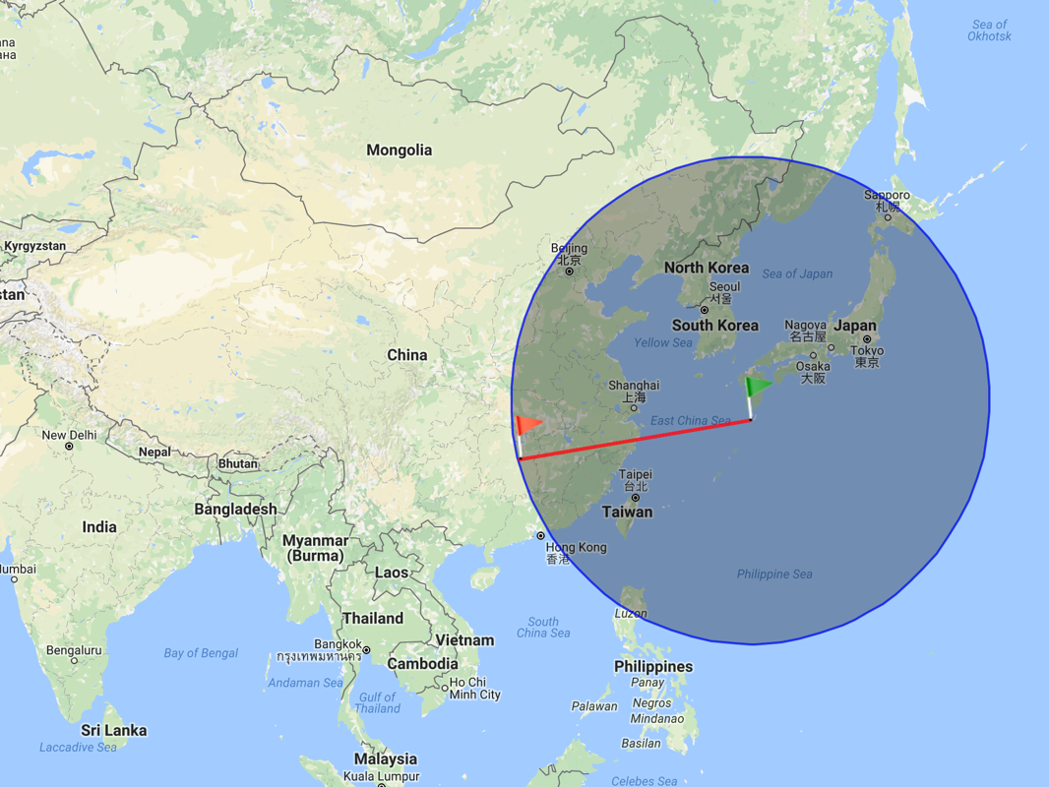
Idea
Improve Geographical Skills
Possible Target Audience
Taxidriver
Police
Fire Workers
Ambulance

Slide 4
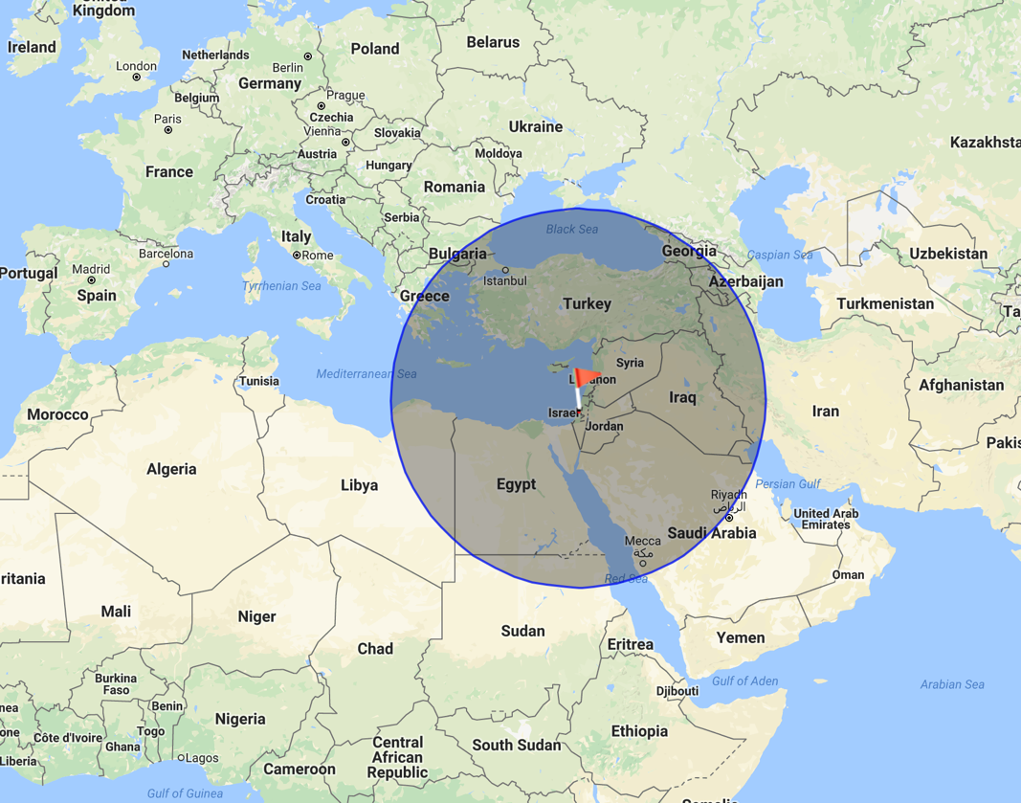
Idea
Highscore
Facebook Integration
Share Scores
Compare to Friends
...

Slide 5
Monetization
In-App purchases for new quizzes
Ads
Offer to POIs to be included ($$)

Slide 6
Data Source
Open Data
Mostly CSV, PDF, TXT, GML Files
Various Data Including
Locations
Events
Streets
Public Buildings
Schools
Parking Lots
Hotel
Drugstores
...

Slide 7
Technology
+ ( )
+

Slide 8

Q&A

